Slide 1
Flower Classification with both traditional and deep learning methods
HU Zongyang (019370910024 ) XIAO Yuhang (119370910010)
LI Zehuan (119370910018) FENG Xuening (019370910019)
24/06/2020

Slide 2
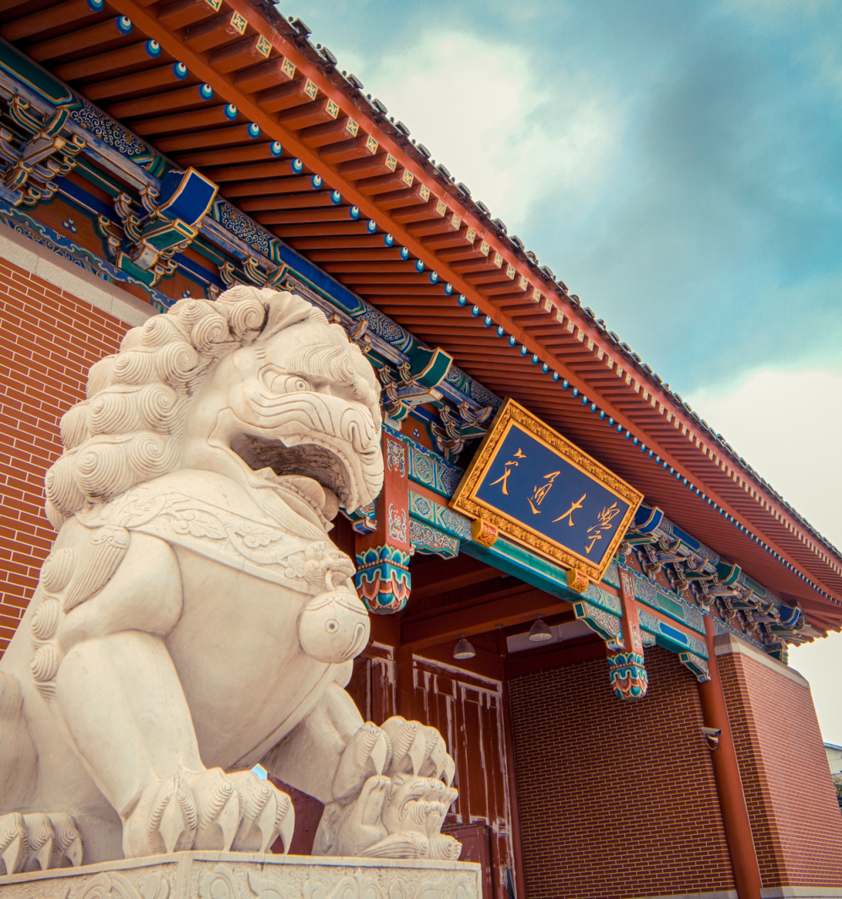
1
Problem Statement
2
Methods
3
Experiments & Results
4
Conclusion

Slide 3
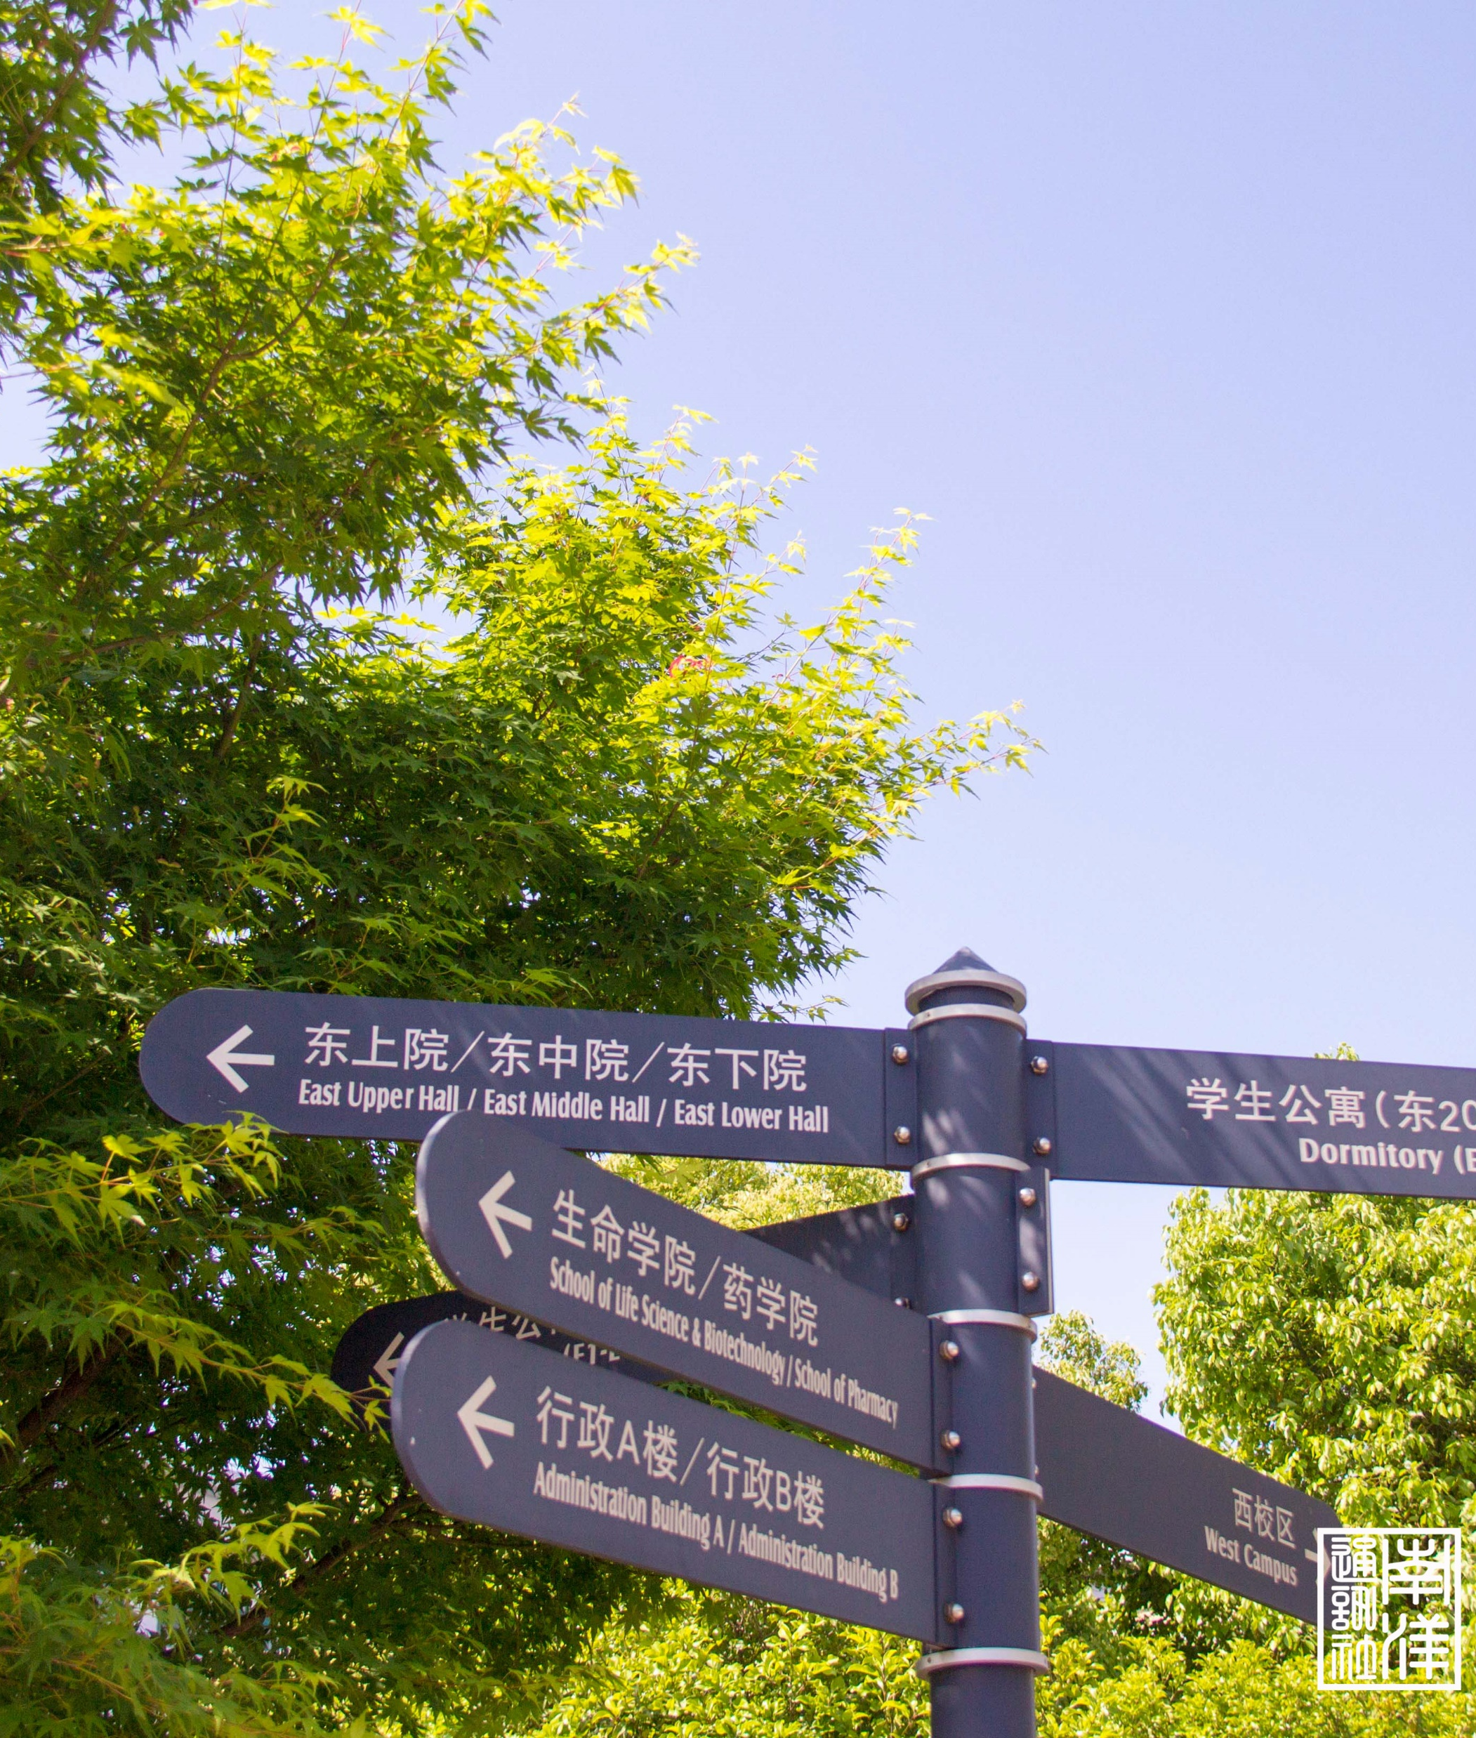
Problem Statement
01
Problem Description
Dataset
Notes:
或许需要feature extraction

Slide 4
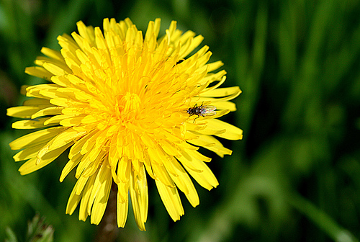
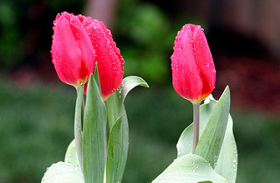
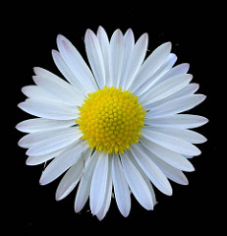
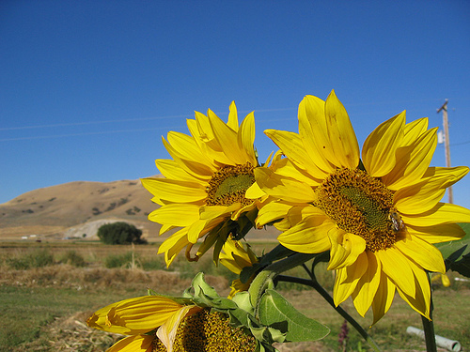

1.1 Problem Statement
Five kinds of flowers
Task: classify flower pictures into 5 types
Traditional method (SVM)
Deep learning method
Computer Vision Final Project
24/06/2020
Notes:
Project Statement/Motivation：介绍项目基本情况，分析数据集Method：大致介绍使用的方法，以及结合项目实际情况，所使用的结构/重要参数 etcExperiments：包括results（主要是准确率）和analysis/discussion（各种方法的优劣，并分析原因）Conclusions：对整体进行总结（项目结果，有哪些可以改进的地方）

Slide 5
1.2 Dataset
Five kinds of flowers: daisy, tulip, rose, sunflower and dandelion
Totally 4323 images
Not high resolution and with various image sizes
Type | Daisy | Tulip | Rose | Sunflower | Dandelion
Amount | 769 | 984 | 784 | 734 | 1052
Computer Vision Final Project
24/06/2020
Notes:
Project Statement/Motivation：介绍项目基本情况，分析数据集Method：大致介绍使用的方法，以及结合项目实际情况，所使用的结构/重要参数 etcExperiments：包括results（主要是准确率？）和analysis/discussion（各种方法的优劣，并分析原因）Conclusions：对整体进行总结（项目结果，有哪些可以改进的地方）

Slide 6
Methods
02
Support Vector Machine (SVM)
CNN
Transfer Learning

Slide 7
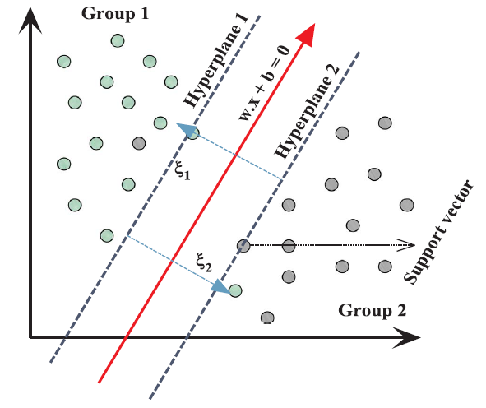
2.1 Support Vector Machine (SVM)
SVM classification
The support vector machine (SVM) is a supervised and statistical learning theory;
--Input data: transformed to a high-dimensional feature;
--The margin: determined by constructing two parallel hyper-planes;
--The larger the margin the better the generalization error of the classifier
Fig.2 Graphical definition of support vector regression.
Computer Vision Final Project
24/06/2020
Notes:
The support vector machine (SVM) is a supervised and statistical learning theory;
SVM manipulates some set of labeled training data and generates input-output mapping functions (i.e. classification function, regression function). Input data is transformed to a high-dimensional feature space by utilizing non-linear kernel functions in case of classification problems. According to classes which have been previously mapped into high-dimensional feature space, a separating hyper-plane is created which maximizes the margin between two data points. The margin is determined by constructing two parallel hyper-planes on each side of the separating margin. The larger the margin the better the generalization error of the classifier is obtained.

Slide 8

2.2 Convolutional Neural Network (CNN)
Convolutional layer Relu Layer Pooling layer Fully connected layer
feature extraction enhance reaction down-sampling connection
Computer Vision Final Project
24/06/2020

Slide 9
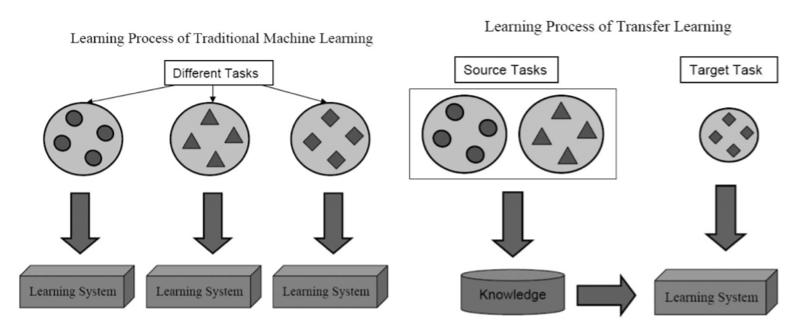
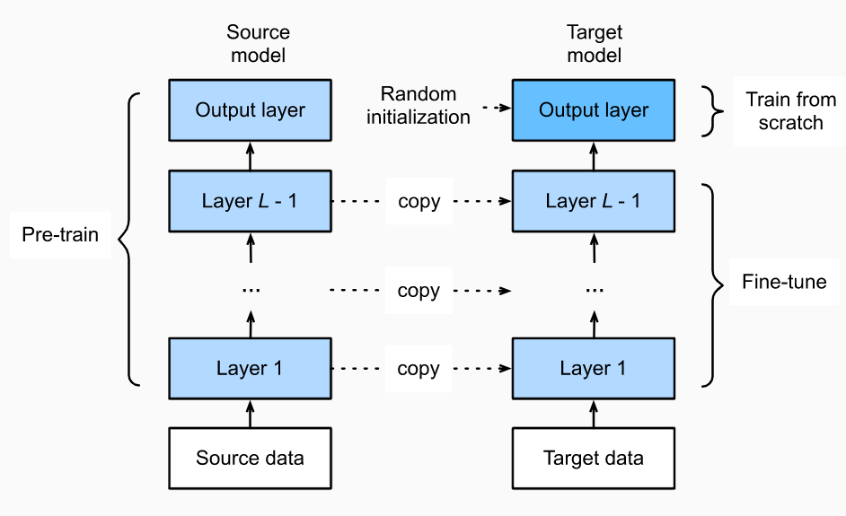
2.3 Transfer Learning
Transfer Learning (TL)
Reuse the knowledge from other similar domains
Approaches
Instance-transfer
Feature-representation-transfer
Parameter-transfer
Relational-knowledge-transfer
Deep Transfer Learning
Fine tuning
Computer Vision Final Project
24/06/2020

Slide 10
Experiments & Results
03
SVM
CNN & Transfer Learning
Notes:
或许需要feature extraction

Slide 11
3.1 SVM
SVM
Training process
Training set
Learning process
Classifier
Feature extraction
Preprocessing
Classification process
Classification results
Test set
Classification process
Computer Vision Final Project
24/06/2020

Slide 12
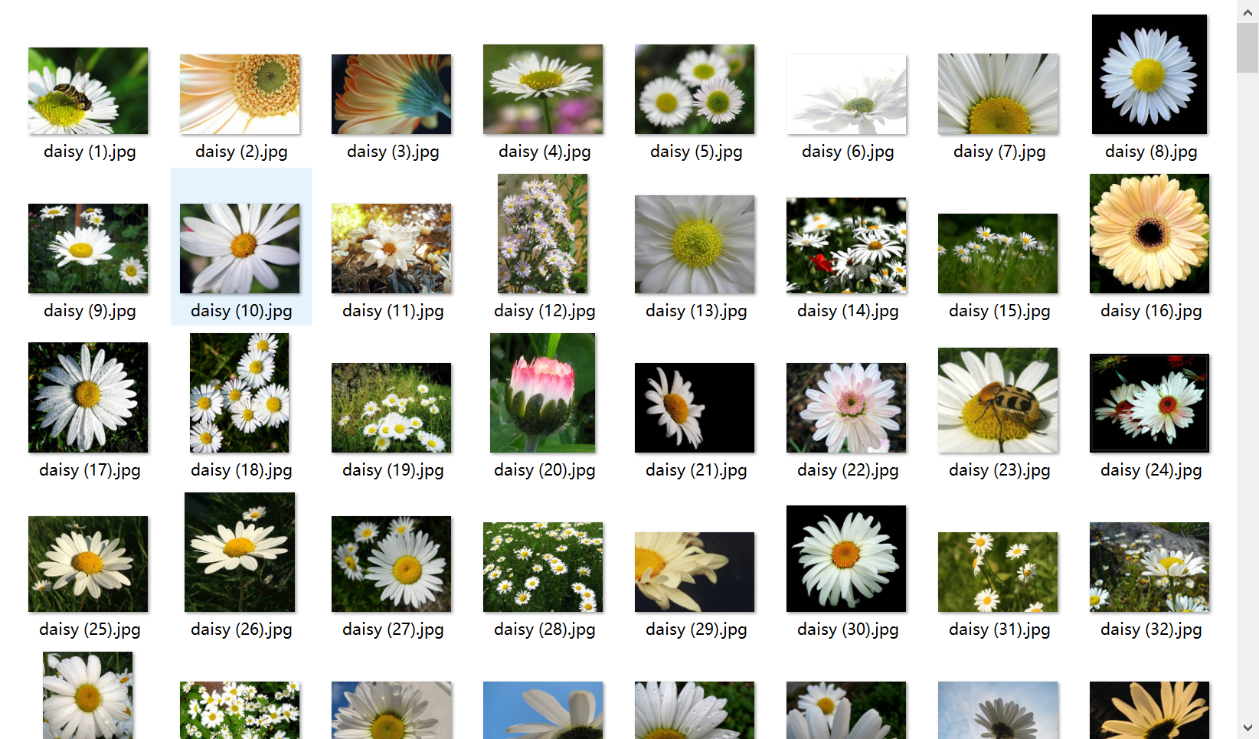
3.1 SVM
Training & Test Set
Training set should be representative
Choose five different kinds of flower to classify (daisy, dandelion, rose, sunflower, tulip).
Training set have no wrong samples
Training set should be as complete as possible
Each sample set choose 500 pictures, totally have 2500 pictures as training set.
Computer Vision Final Project
24/06/2020
Notes:
Training set and test set

Slide 13
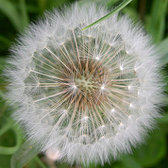
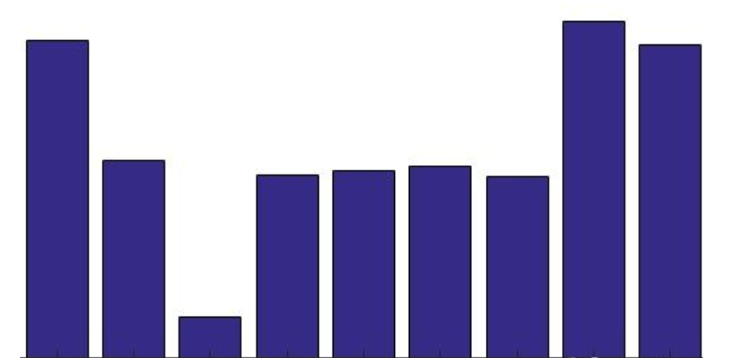
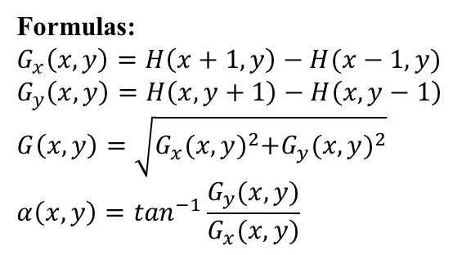
3.1 SVM
Histogram of oriented gradients (HOG)
Normalized image and resize
Compute the gradient
Calculate gradient histogram
Make the cells into block
picture size 256*256
cell size 4*4
9*1 histogram
Method:
Take each four cells into a block, each block 36 categories
Use a slide window
Formulas:
$$G_{x}\left(x,y\right)=H\left(x+1,y\right)−H(x−1,y)$$
$$G_{y}\left(x,y\right)=H\left(x,y+1\right)−H\left(x,y−1\right)$$
$$G\left(x,y\right)=\sqrt{G_{x}{(x,y)}^{2}+G_{y}{(x,y)}^{2}}$$
$$α\left(x,y\right)=\tan^{−1}\frac{G_{y}(x,y)}{G_{x}(x,y)}$$
Method:
Gamma compression
Objective:
Improve the robustness to illumination change
Method:
20 degrees as a category, 9 categories total
Collect HOG features
Total 142884 categories
Computer Vision Final Project
24/06/2020
Notes:
Take the picture into 256*256. cell size is 4*4.
Function: [hog_feature, vis_hog] = extractHOGFeatures(img,'CellSize',cellSize);

Slide 14
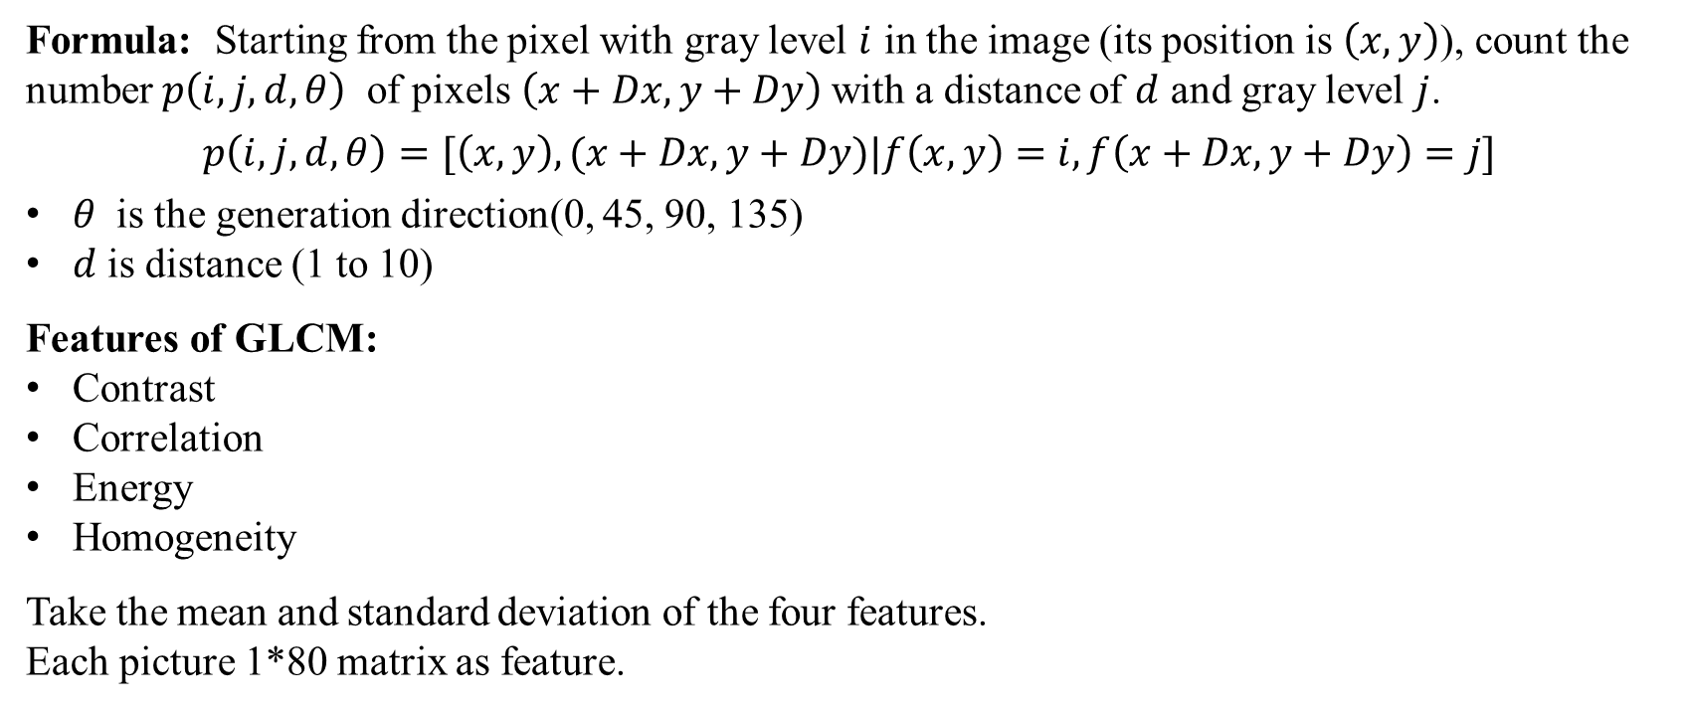
3.1 SVM
Gray Level Co-occurrence Matrix (GLCM）
Formula: Starting from the pixel with gray level $i$ in the image (its position is $\left(x,y\right)$), count the number $p\left(i,j,d,θ\right)$ of pixels $\left(x+Dx,y+Dy\right)$with a distance of $d$ and gray level $j$.
$$p\left(i,j,d,θ\right)=[\left(x,y\right),(x+Dx,y+Dy)|f\left(x,y\right)=i,f\left(x+Dx,y+Dy\right)=j]$$
$θ$ is the generation direction(0, 45, 90, 135)
$d$is distance (1 to 10)
Features of GLCM:
Contrast
Correlation
Energy
Homogeneity
Take the mean and standard deviation of the four features.
Each picture 1*80 matrix as feature.
Computer Vision Final Project
24/06/2020
Notes:
glcm = graycomatrix(image, 'Offset', [0,i]);
stats = graycoprops(glcm);
The gray level co-occurrence matrix of an image can reflect the comprehensive information of the gray level of an image about the direction, the adjacent interval and the change amplitude. It is the basis of analyzing the local patterns of an image and their arrangement rules.

Slide 15
3.1 SVM
LS-SVM
The main difference between standard SVM and LS-SVM :
inequality constraint is replaced by equality constraint.
code implementation:
Using RBF kernel
Notes:
LS-SVM a reformulated version of standard SVM is used in present study. The main difference between standard SVM and LS-SVM is that here inequality constraint is replaced by equality constraint; as a result, it is capable of solving regression problem more efficiently.
We use RBF kernel in this project. Because RBF kernel can map samples to a higher dimensional space, it can deal with the non-linear relationship between class labels and features. It is a kernel function with strong locality and has a high flexibility

Slide 16
3.1 SVM
SVM
Accuracy of 0.69 on the test set.
Confusion matrix
Possible reasons for the low accuracy:
No color information applied as classification input
Daisy and dandelion should have more samples for training
 | daisy | dandelion | rose | sunflower | tulip
daisy | 131 | 29 | 14 | 12 | 14
dandelion | 34 | 120 | 13 | 15 | 18
rose | 16 | 14 | 142 | 12 | 16
sunflower | 10 | 11 | 13 | 154 | 12
tulip | 17 | 16 | 16 | 10 | 141
Notes:
Confusion matrix is a common expression in the field of pattern recognition. It describes the relationship between the real attributes of sample data and the type of recognition results, which is a common method to evaluate the performance of classifier.

Slide 17
3.2 CNN & Transfer learning
CNN
Implementation details:
Data preprocessing:
Resize to 150*150 pixel
Data Augmentation:
rotation, zooming, shifting, flipping
Loss function:
Cross-entropy
Optimizer:
Adam
Tricks:
ReduceLROnPlateau
Input
150*150
cov2D
filters = 32
kernel = 5*5
cov2D
filters = 64
kernel = 3*3
cov2D
filters = 96
kernel = 3*3
cov2D
filters = 96
kernel = 3*3
Fully connected layer
Softmax classifier
Computer Vision Final Project
24/06/2020
Notes:
CNN
Dataset split
Then I will introduce the experiments and results of dl part
Firstly we resize our images to a same size and also since our dataset is relatively small, we also do the data augmentation to enlarge our dataset.
After that we construct a cnn model as the figure shows. And the implementation detals…

Slide 18
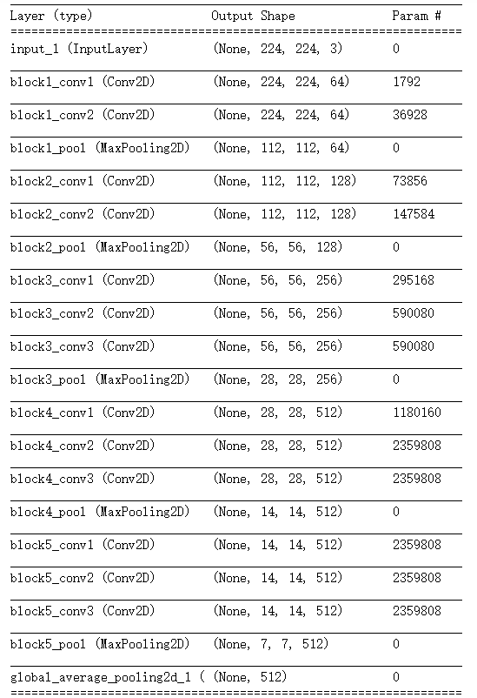
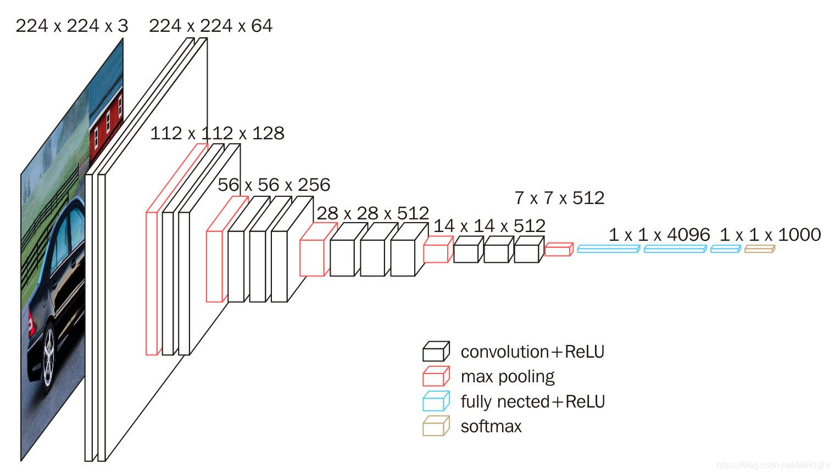
3.2 CNN & Transfer learning
Deep Transfer Learning
Base model
vgg16 (without the top layer)
Fine tuning
Successively unfreeze some top block(s)
Computer Vision Final Project
24/06/2020
Notes:
TL
Optimizer Adam
Loss: categorical cross-entropy
Metrics: accuracy
As for transfer learning part, we use vgg16 without … as the base model. The architecture of vgg16 is shown in these figures.
We firstly build our own classifier on top of the base model
And the do the fine tuning by successively …

Slide 19
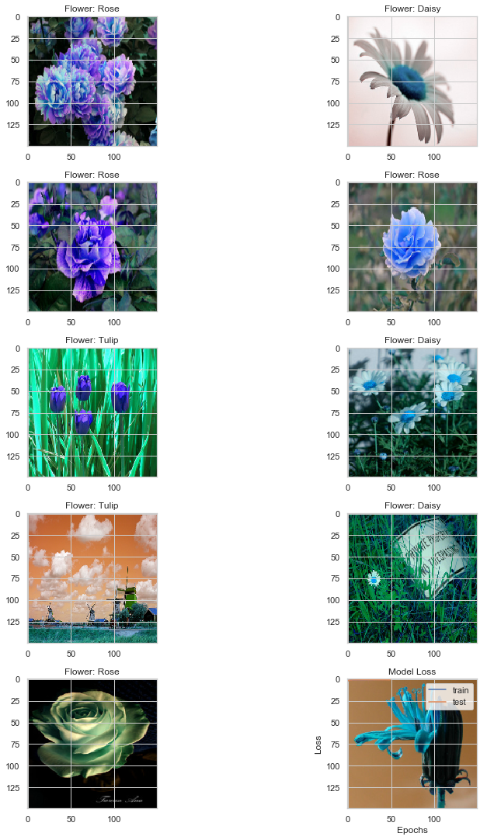
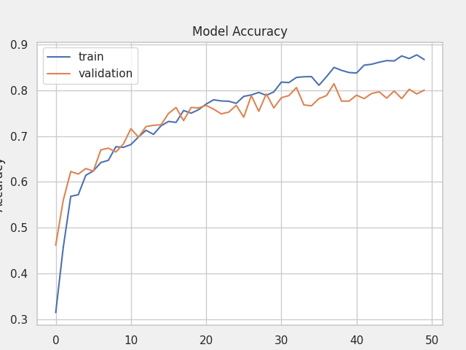
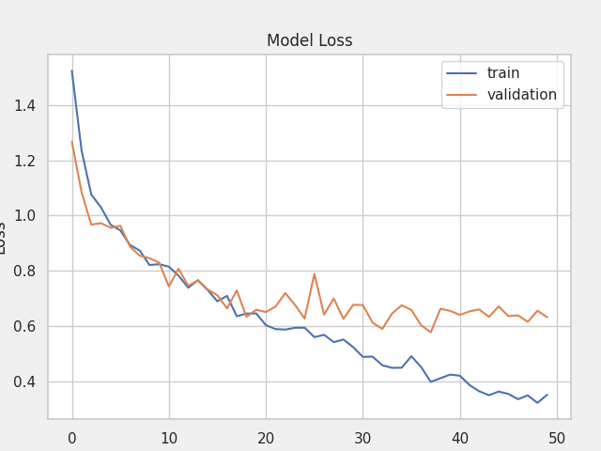
3.2 CNN & Transfer learning
CNN
Computer Vision Final Project
24/06/2020
Notes:
CNN
For the experimental results, the cnn model can achieve about 0.78 accuracy on the validation set

Slide 20
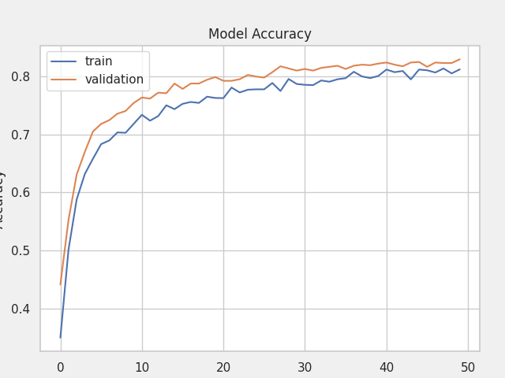
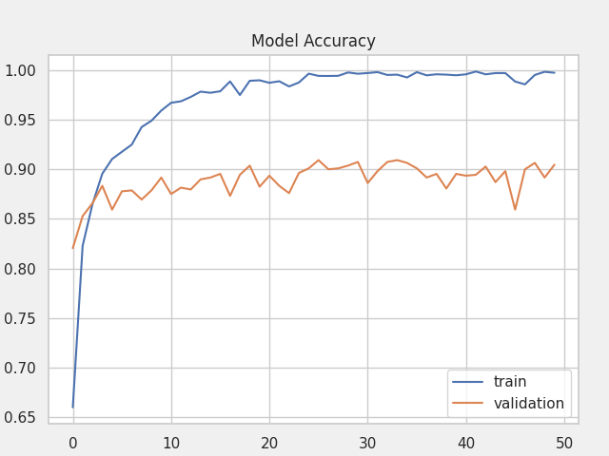
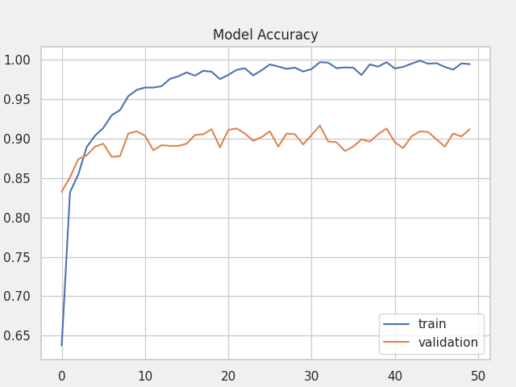
3.2 CNN & Transfer learning
CNN
Vgg16 no-top + our FC layer
Unfreeze last 1 blocks
Unfreeze last 2 blocks
Computer Vision Final Project
24/06/2020
Notes:
Fine tuning can improve the accuracy on validation set by almost 10%
And with fine tuning, it clear that we can obtain obvous improment compared with cnn
Finally we can

Slide 21
Conclusion
04
Notes:
或许需要feature extraction

Slide 22
4 Conclusion
Summary
We apply both traditional & deep neural network method on the flower classification task.
Deep transfer learning can contribute much if used properly when lacking data.
SVM method can have a good classification result if proper features are chosen.
Future work
Add color features for SVM method
Data augmentation
Computer Vision Final Project
24/06/2020

Slide 23
Workload Division
Task |  | Member(s)
Image data analysis |  | All
Feature extraction |  | HU Zongyang
SVM |  | XIAO Yuhang
DL | CNN | LI Zehuan
 | Transfer learning using pretrained model | FENG Xuening
Result analysis and discussion |  | All
Presentation & report |  | All
Computer Vision Final Project
24/06/2020

Slide 24
Thanks for Listening

